Slide 1


































































































































































ODD FELLOWS FOR UKRAINE#2

Slide 2







































































































































































































ODD FELLOWS FOR UKRAINE#2

Slide 3





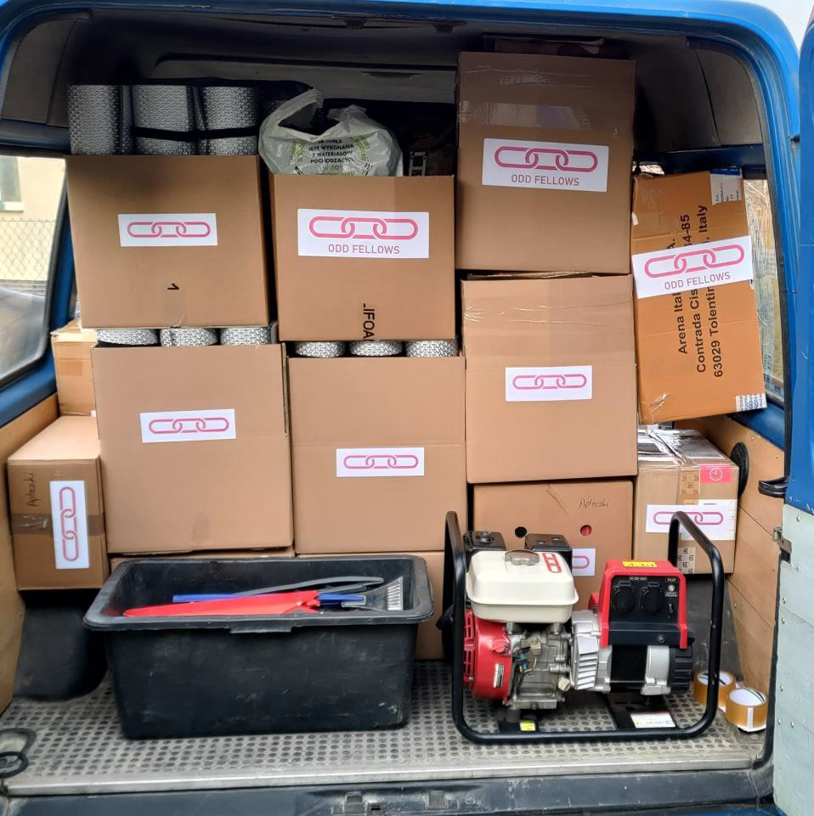


























































































































































ODD FELLOWS FOR UKRAINE#2

Slide 4






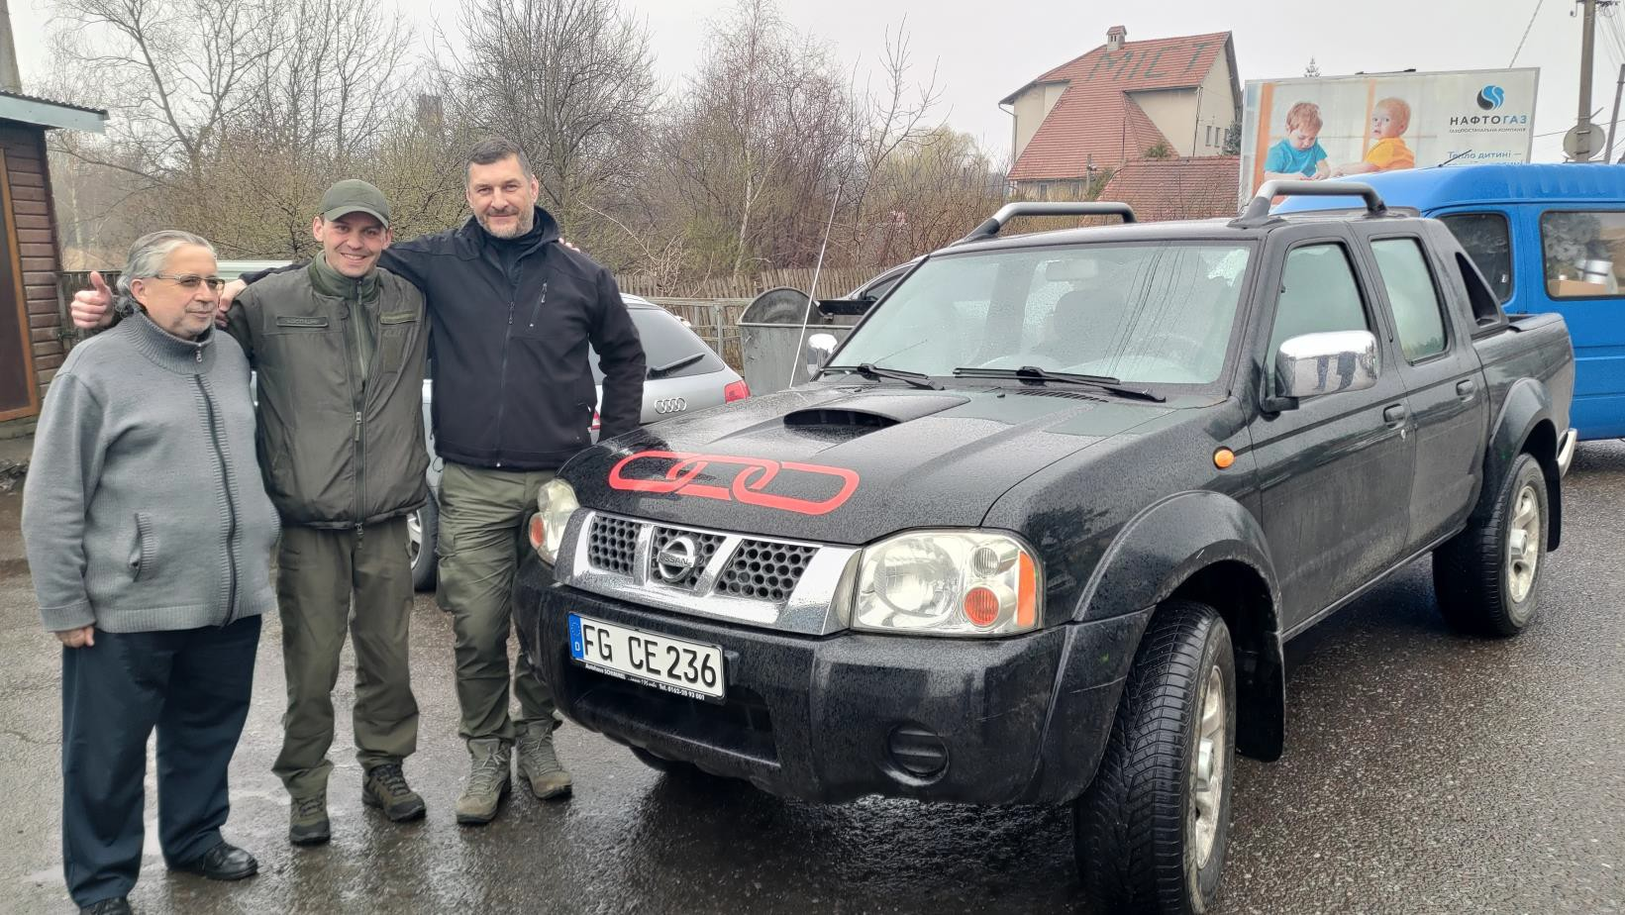












































ODD FELLOWS FOR UKRAINE#2

Slide 5
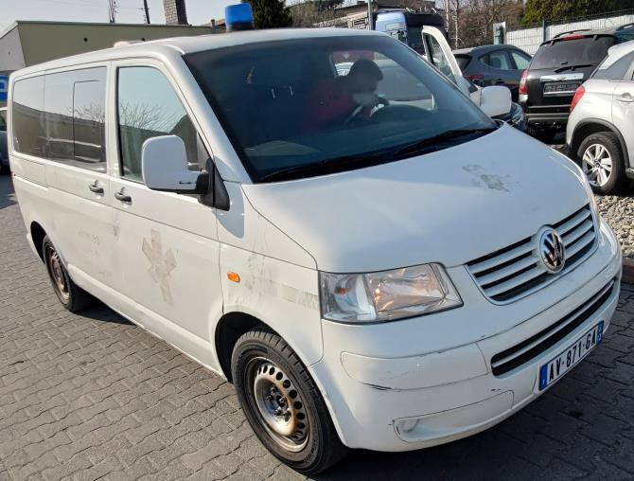
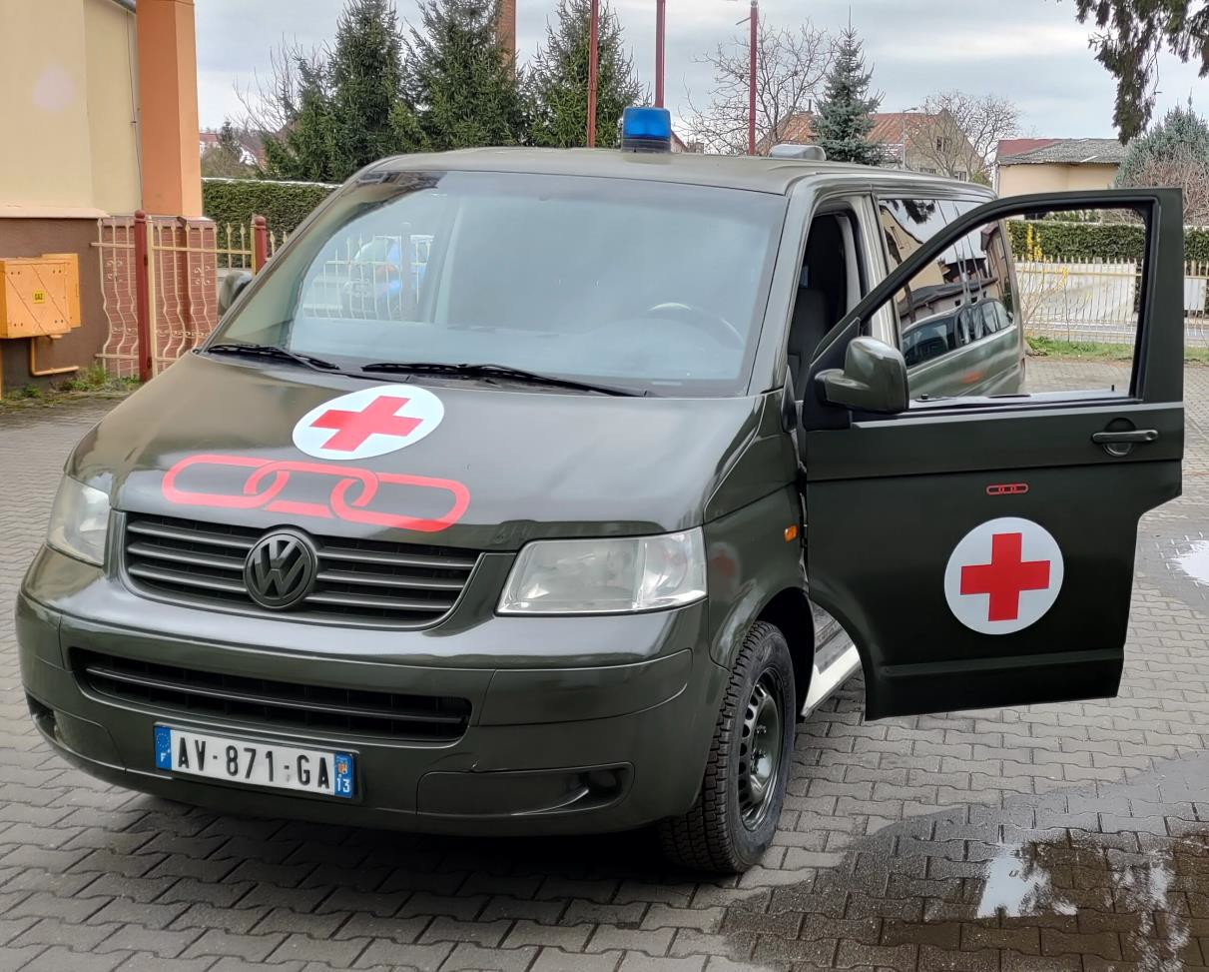
























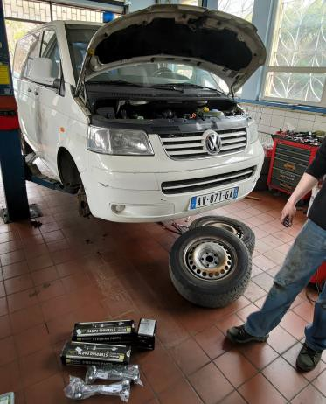
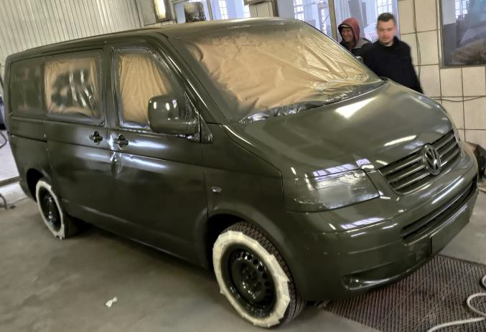
ODD FELLOWS FOR UKRAINE#2

Slide 6

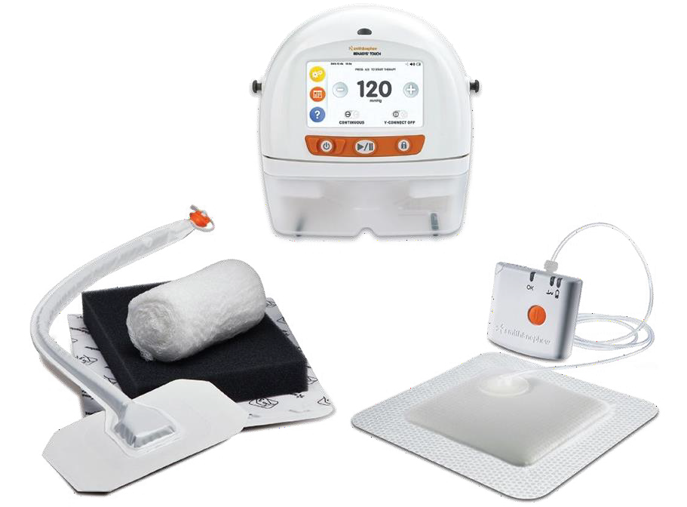































ODD FELLOWS FOR UKRAINE#2

Slide 7







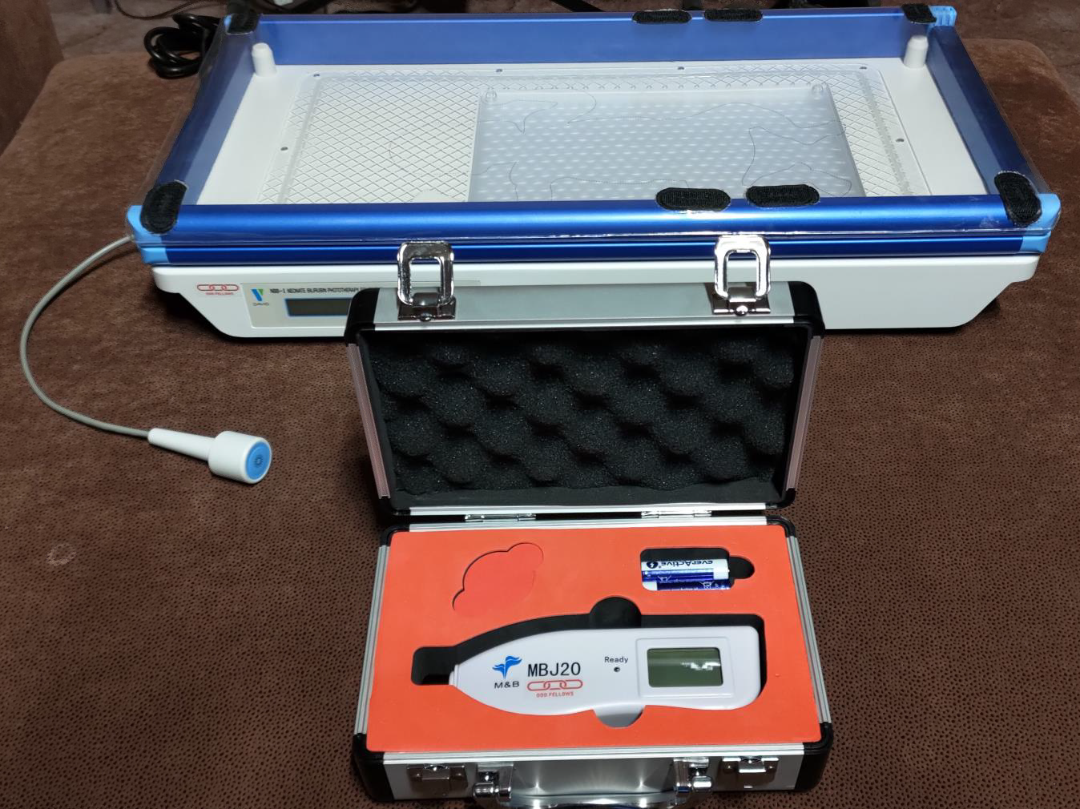



































ODD FELLOWS FOR UKRAINE#2
-

Slide 8
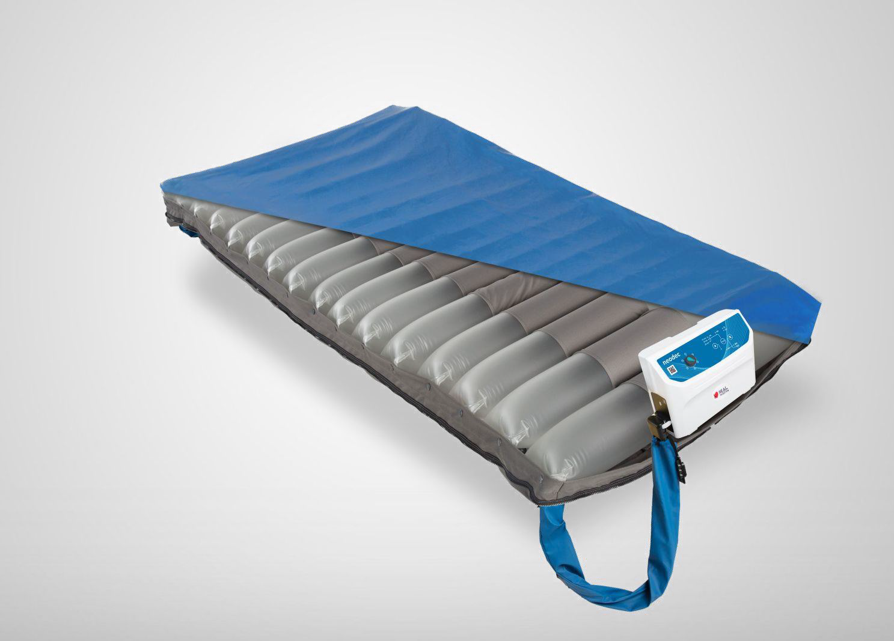





































































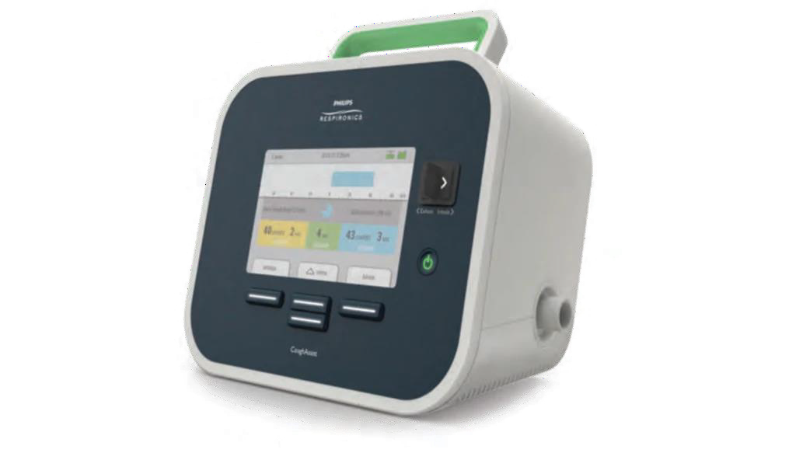
























ODD FELLOWS FOR UKRAINE#2

Slide 9






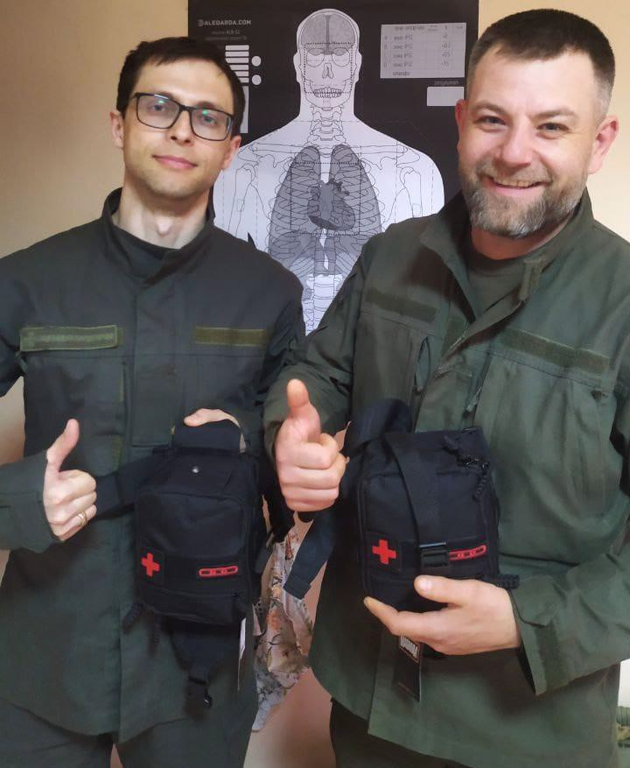
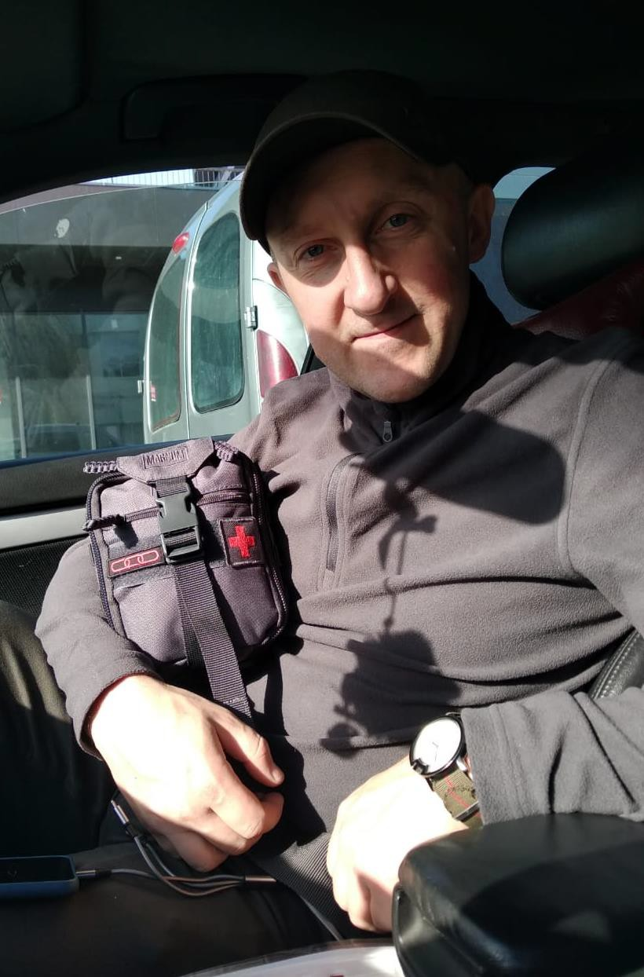










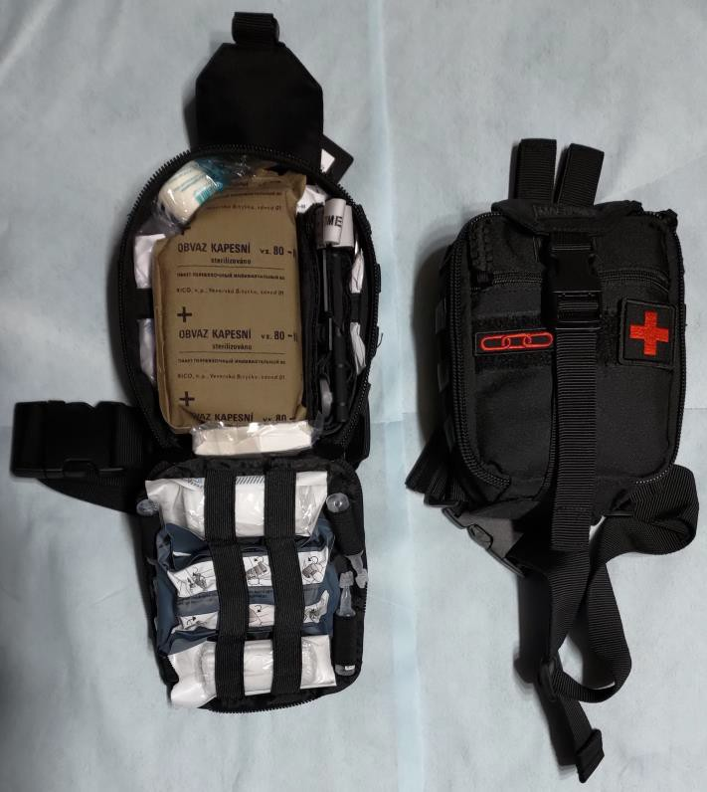









ODD FELLOWS FOR UKRAINE#2
-

Slide 10

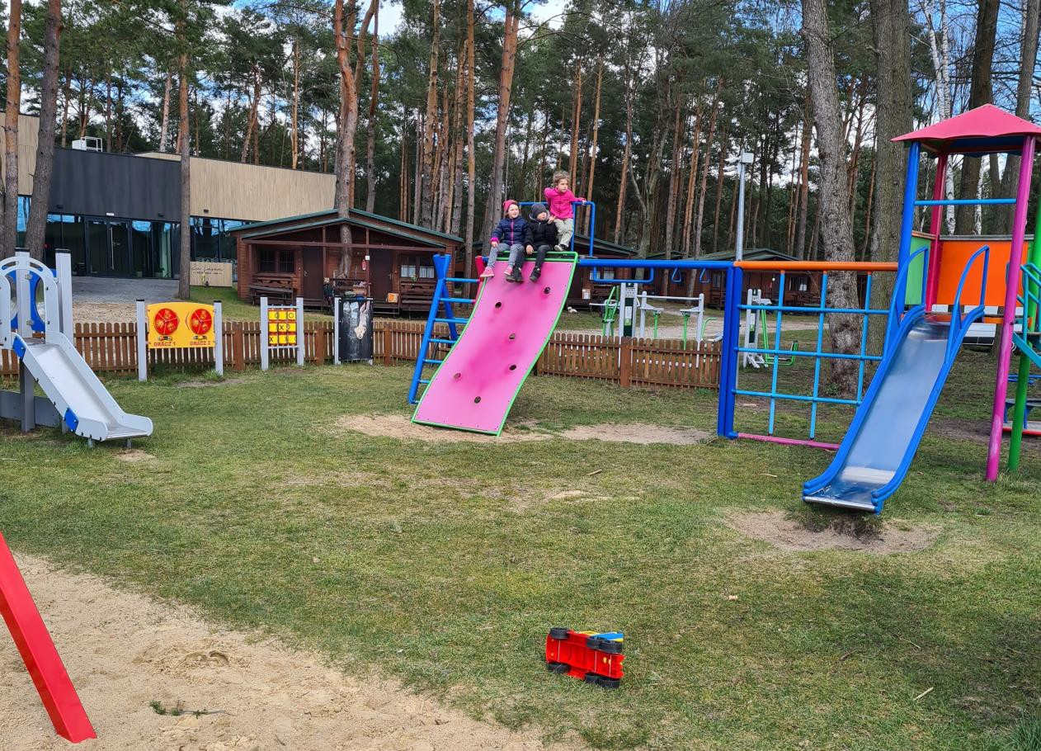























































































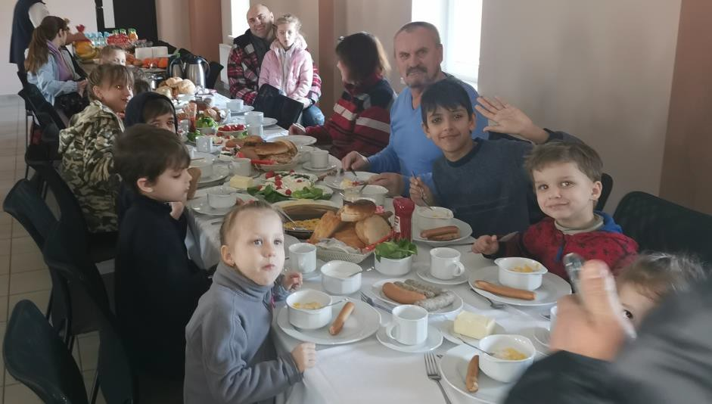
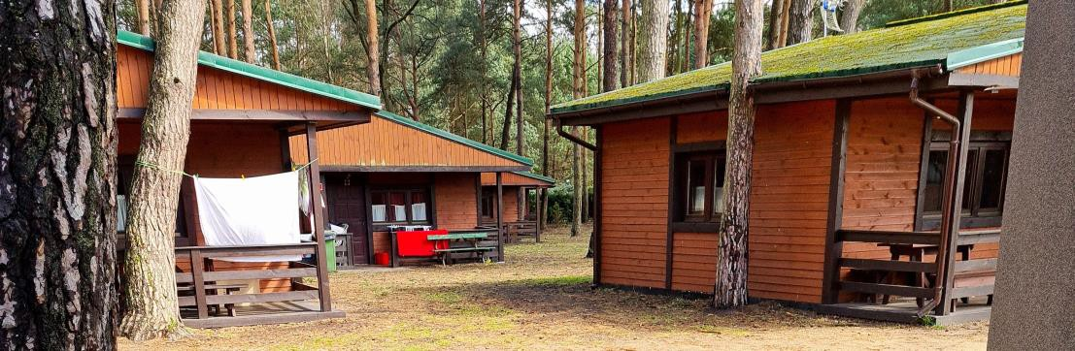



























ODD FELLOWS FOR UKRAINE#2

Slide 11





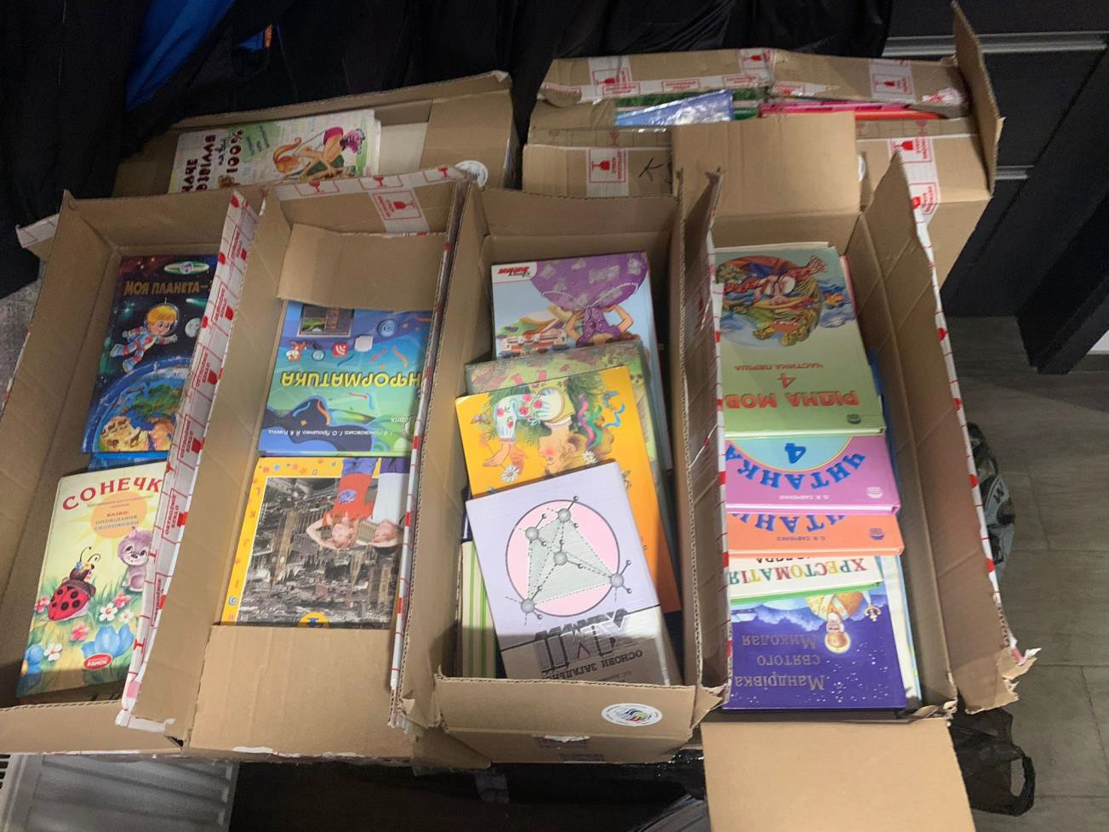
















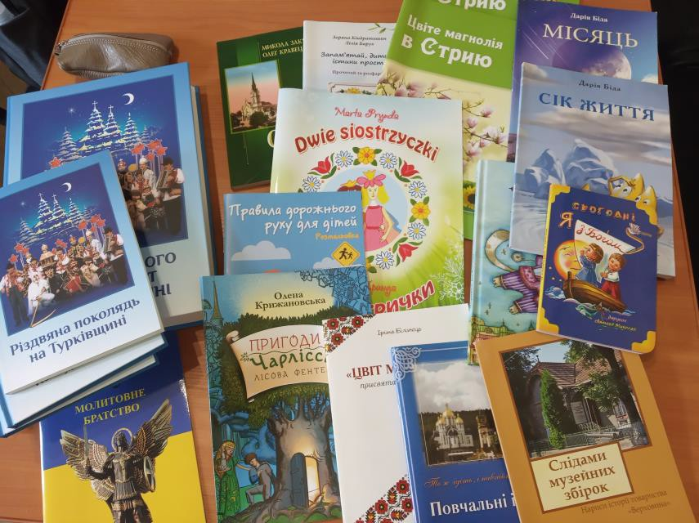
ODD FELLOWS FOR UKRAINE#2

Slide 12




























































ODD FELLOWS FOR UKRAINE#2
HELP4UKR@IOOF.PL
HTTPS://FORUM.IOOF.PL/VIEWFORUM.PHP?F=32

Slide 13
ODD FELLOWS FOR UKRAINE#2

